Slide 1
Module 1
Introduction and Overview of Computer Architecture
Introduction to computer systems - Overview of Organization and Architecture –Functional components of a computer -Registers and register files-Interconnection of components- Organization of the von Neumann machine and Harvard architecture-Performance of processor

Slide 2
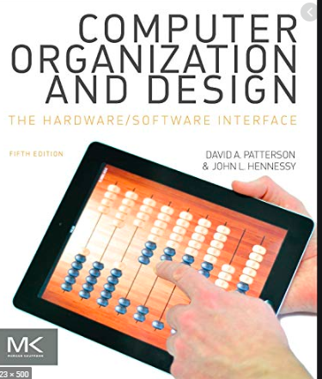
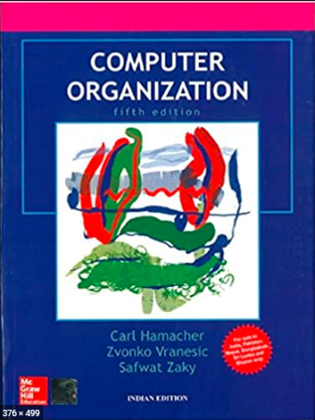
Text Book(s)
David A. Patterson and . John L. Hennessy ―Computer Organization and Design-The Hardware/Software Interface‖ 5th edition, Morgan Kaufmann, 2011.
Carl Hamacher, Zvonko Vranesic, Safwat Zaky, Computer organization, Mc Graw Hill, Fifth edition ,Reprint 2011.

Slide 3
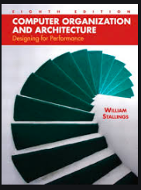
Reference Book
W. Stallings, Computer organization and architecture, Prentice-Hall, 8th edition, 2009

Slide 4
Introduction to computer systems
A computer system is a electronic device
This device takes the input from the user, process the given input as per the requirement of the user and produces the output to the user in a meaningful manner

Slide 5
Introduction to computer systems
An user interacts with computer system with the help of application software and this application software takes the input from the user
Application software communicates with the operating system for required operation of the user, finally returns the results to the output device.

Slide 6
Introduction to computer systems
Any computer consists of hardware components as well as software components

Slide 7
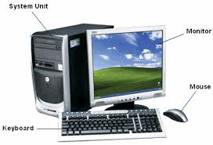
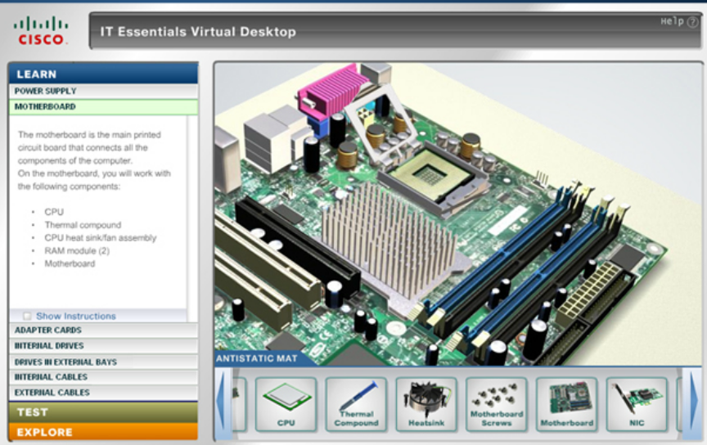
Hardware components

Slide 8
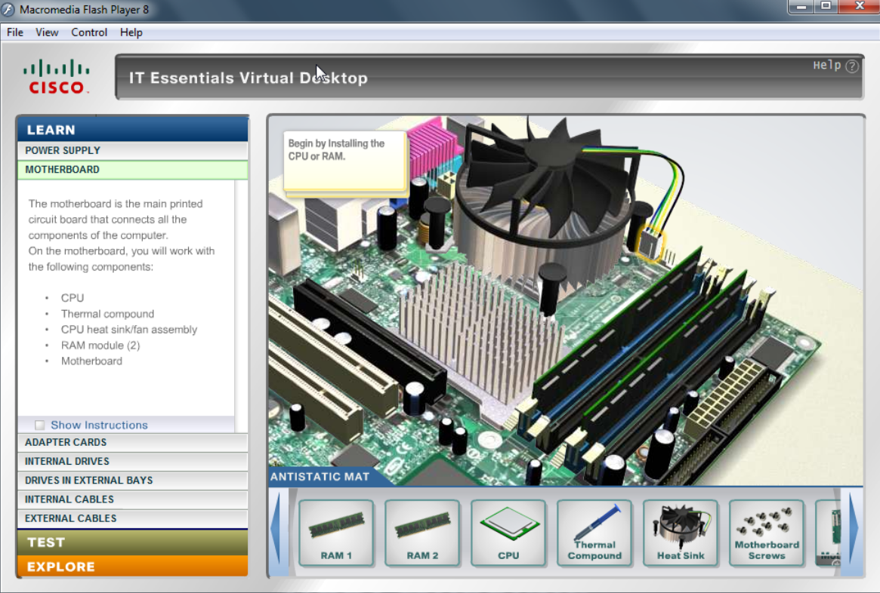

Slide 9

Software components

Slide 10
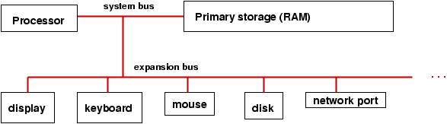
What is computer architecture?
Computer architecture deals with the functionality of every hardware unit of a CPU. i.e. what a specific hardware unit works in a computer
Computer architecture is a specification detailing how a set of software and hardware technology standards interact to form a computer system or platform.
It refers to the system attributes visible to a user and what is the direct impact of these attributes on the program execution.

Slide 11
What is computer organization?
Computer organization deals with the implementation of every hardware unit of a CPU. i.e. how a specific hardware unit works in a computer
It refers to the operational units of the hardware device and interconnections between various hardware devices realize the architectural specifications.

Slide 12
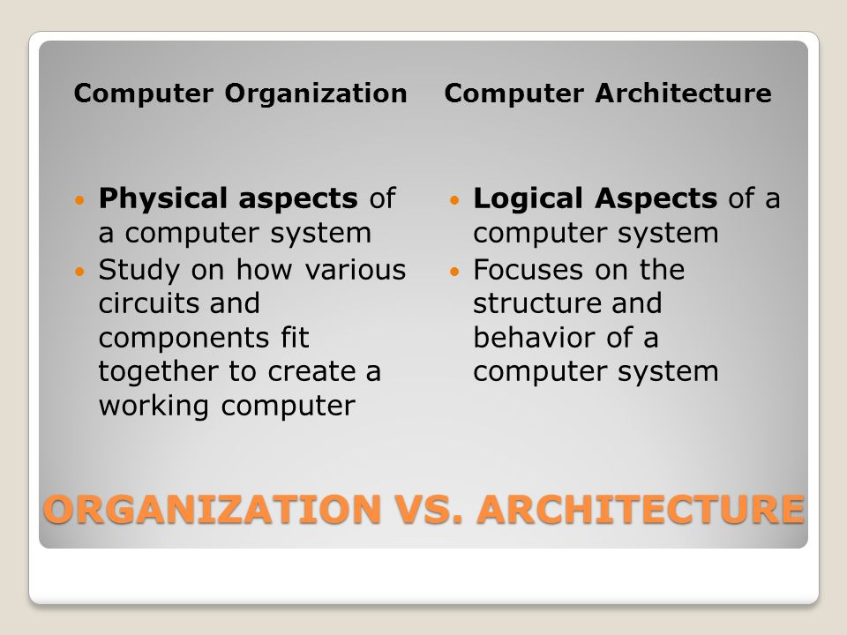

Slide 13
Functions of a computer
There are 4 basic functions. They are:
Processing of the data
Storage of the data
Movement of the data
Controlling

Slide 14
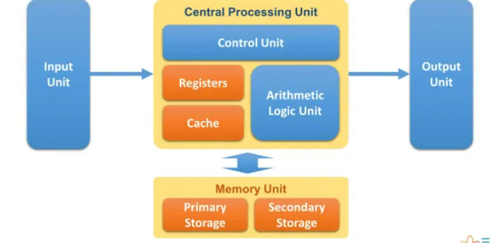
Functional components of a computer
There are 4 functional components of a computer. They are:
CPU (Central Processing Unit)
Main memory
I/O (Input/output)
System interconnection

Slide 15
Functional components of a computer
CPU
ALU
Input
Control Unit
Output
Data
Data
Registers
Data
Memory

Slide 16
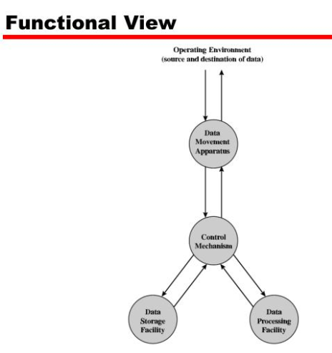

Slide 17
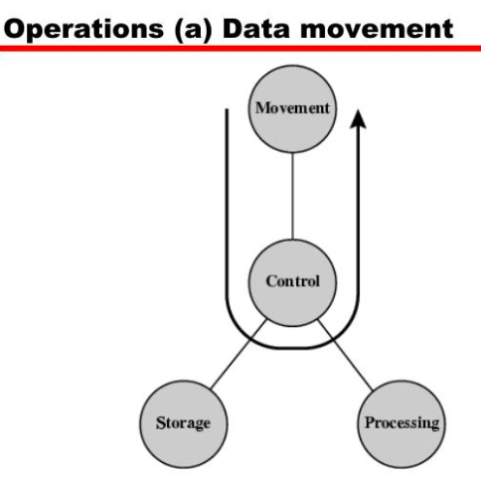
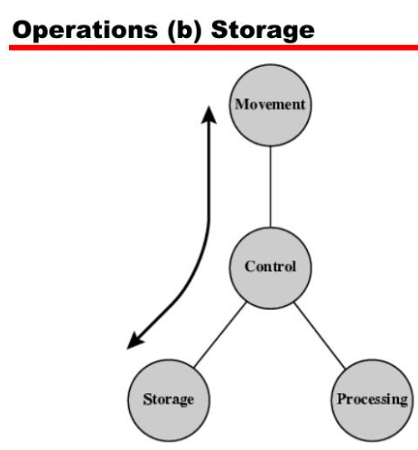

Slide 18
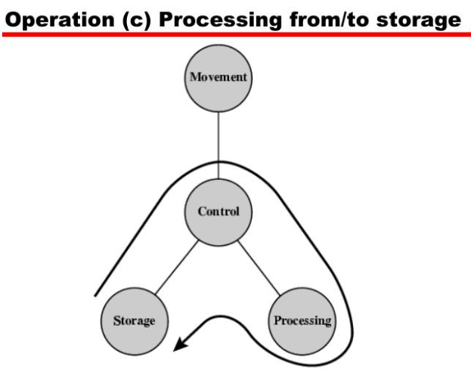

Slide 19
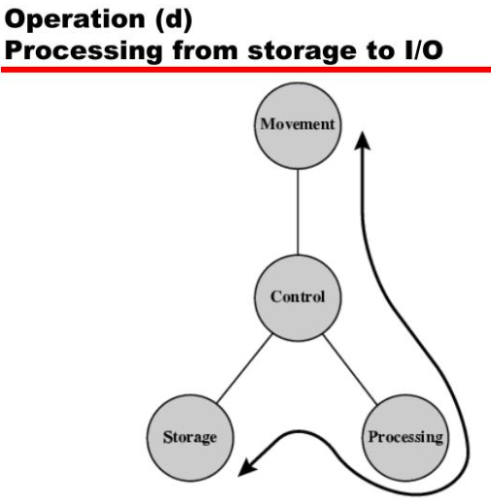

Slide 20
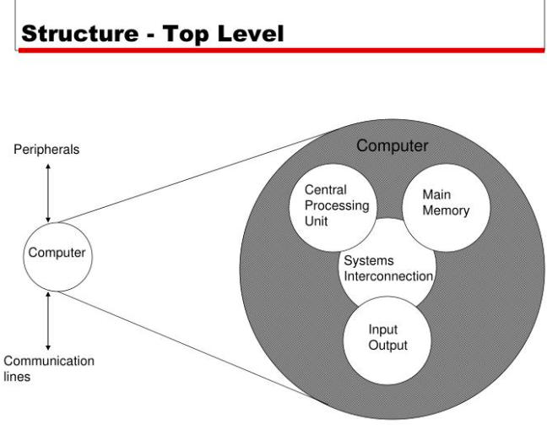

Slide 21
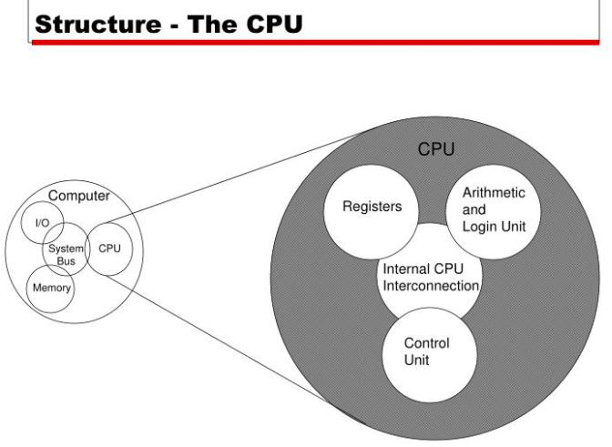

Slide 22
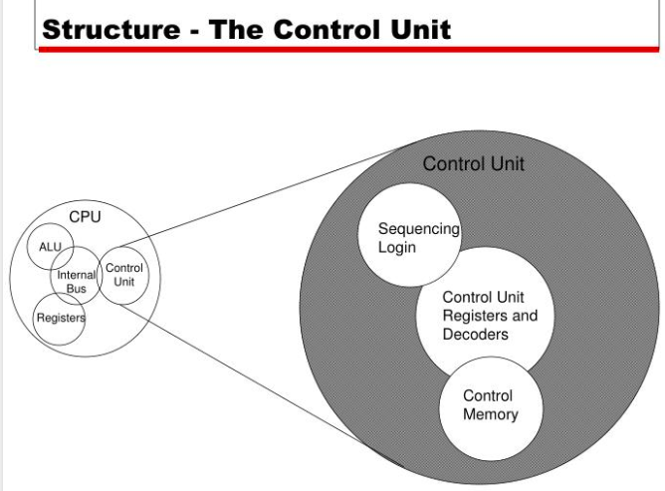

Slide 23
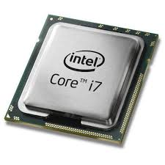
CPU
ALU (Arithmetic & Logic Unit): This unit performs the data processing functions of a computer
Control unit:
Coordinates the tasks between the computer components.
It takes the data from input devices
Sends the input to processing units
Transmits the final result/data to output devices.
Registers: This is a storage unit within the CPU. The data in this unit is collected from the higher memory components (i.e. cache).

Slide 24
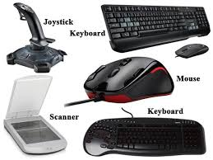
Input unit
Input units are used to provide the input data to the computer to solve the problem given to the computer.
The commonly used input devices are shown in the diagram.

Slide 25
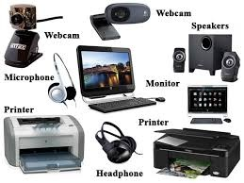
Output unit
The output devices are used to produce the results which are processed by the computer system.
The most commonly used output devices are shown in the diagram.

Slide 26
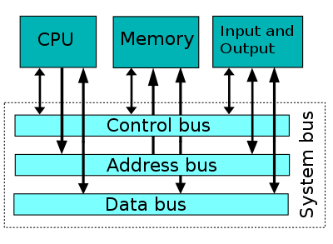
System interconnection
A mechanism that provides for communication among various components of a computer like CPU, main memory, secondary memory etc.
System bus is very common mechanism for connecting such components

Slide 27
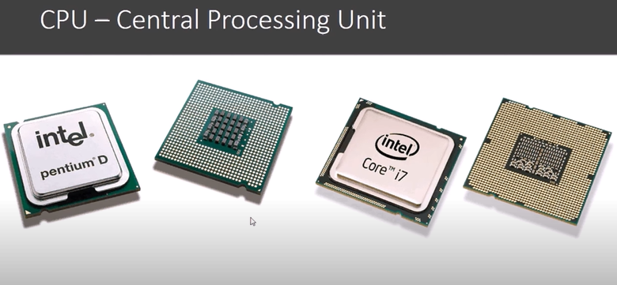

Slide 28

Where operating system will be stored inn Computer? Post your answer in chat box

Slide 29
Where operating system will be stored in Computer?
It resides on your Hard Drive. If you're a Windows user, it's on your C drive by default.

Slide 30
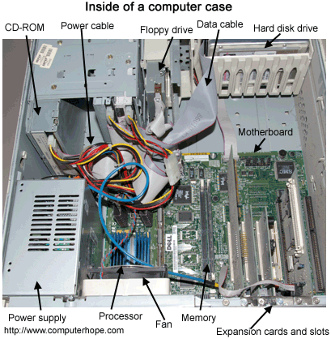
Functional Components of a Computer

Slide 31
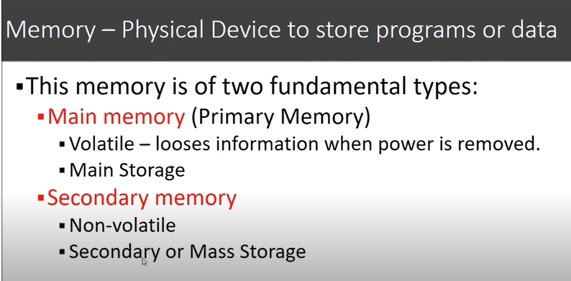

Slide 32
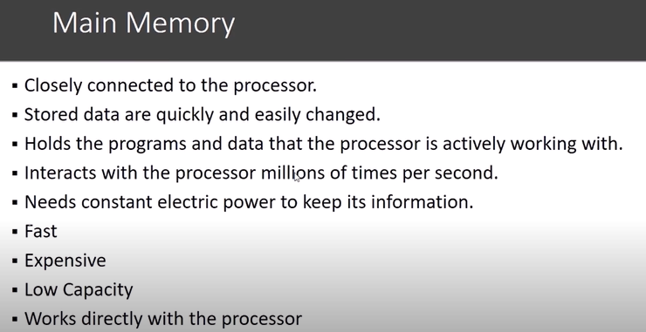

Slide 33
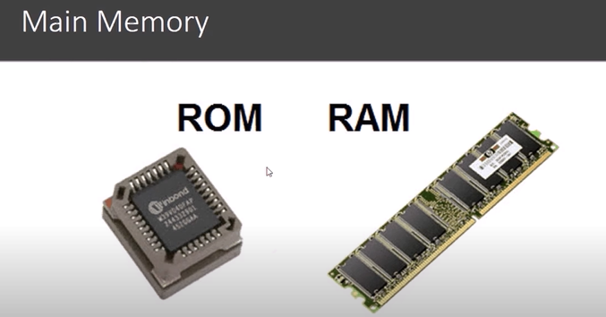

Slide 34
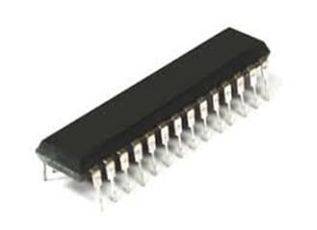
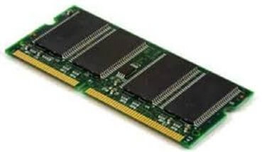
What is RAM?
The information stored in this type of memory is lost when the power supply to the PC or laptop is switched off.
SRAM
DRAM

Slide 35
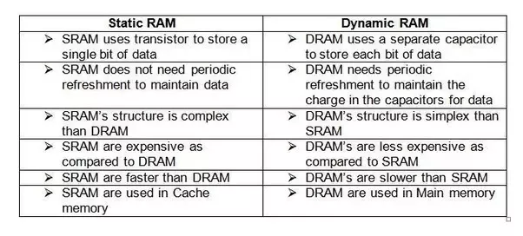

Slide 36
ROM (Read Only Memory)
Read-only memory is a type of non-volatile memory used in computers and other electronic devices.
Data stored in ROM cannot be electronically modified after the manufacture of the memory device.
Data stored in ROM is retained even after the computer is turned off ie, non-volatile. Types of ROM:
Programmable ROM, where the data is written after the memory chip has been created. It is non-volatile.
Erasable Programmable ROM, where the data on this non-volatile memory chip can be erased by exposing it to high-intensity UV light.
Electrically Erasable Programmable ROM, where the data on this non-volatile memory chip can be electrically erased using field electron emission.
Mask ROM, in which the data is written during the manufacturing of the memory chip.

Slide 37
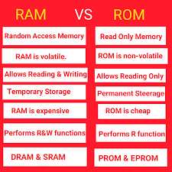

Slide 38
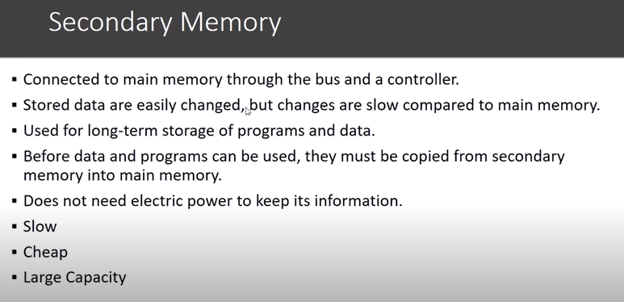

Slide 39
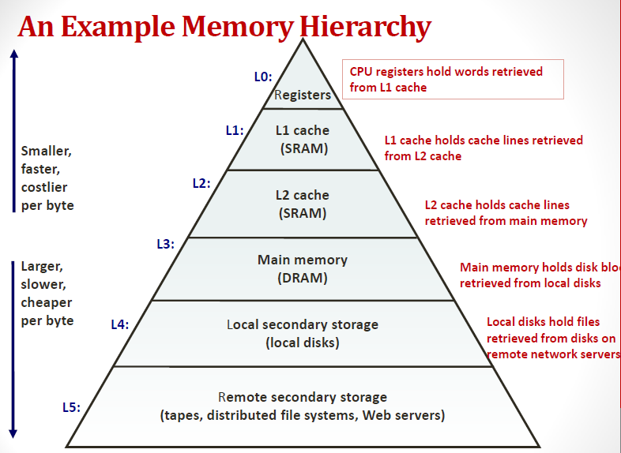
Access Time
Storage

Slide 40
When your computer is turned on how the Operating System will start its functionality???
Post your answer in chat box

Slide 41
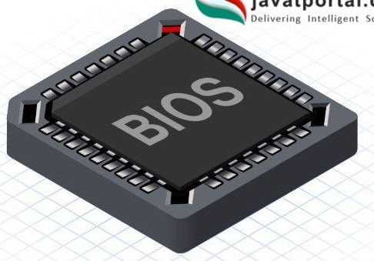
When your computer is turned on how the Operating System will start its functionality???
When a computer is turned on, the BIOS activates the disk drives where it find the first piece of operating system : Bootstrap Loader.
The Bootstrap Loader is a small program which loads the operating system into memory and allow it's operation.

Slide 42
Interconnection of components

Slide 43
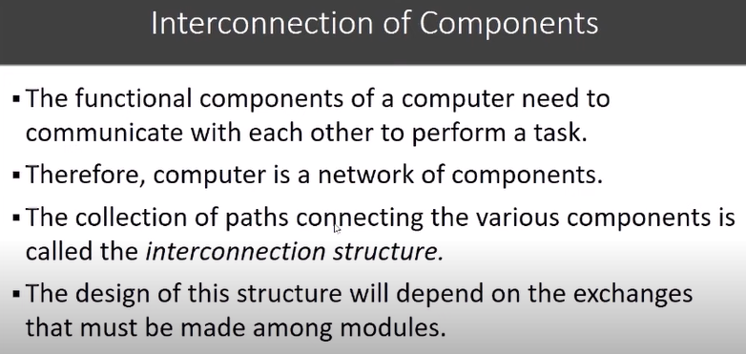

Slide 44
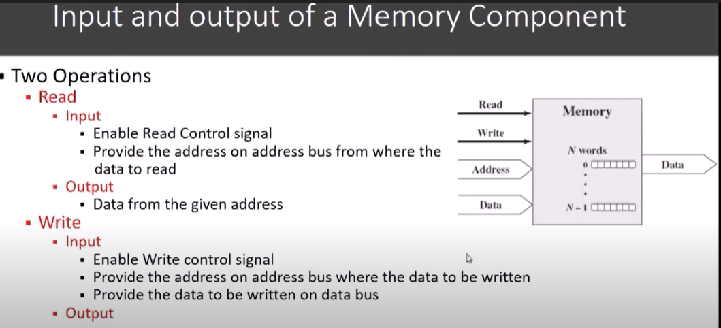

Slide 45
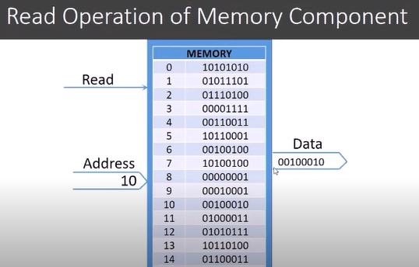

Slide 46
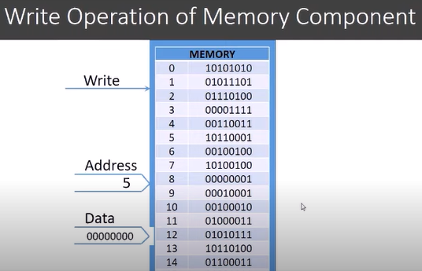

Slide 47
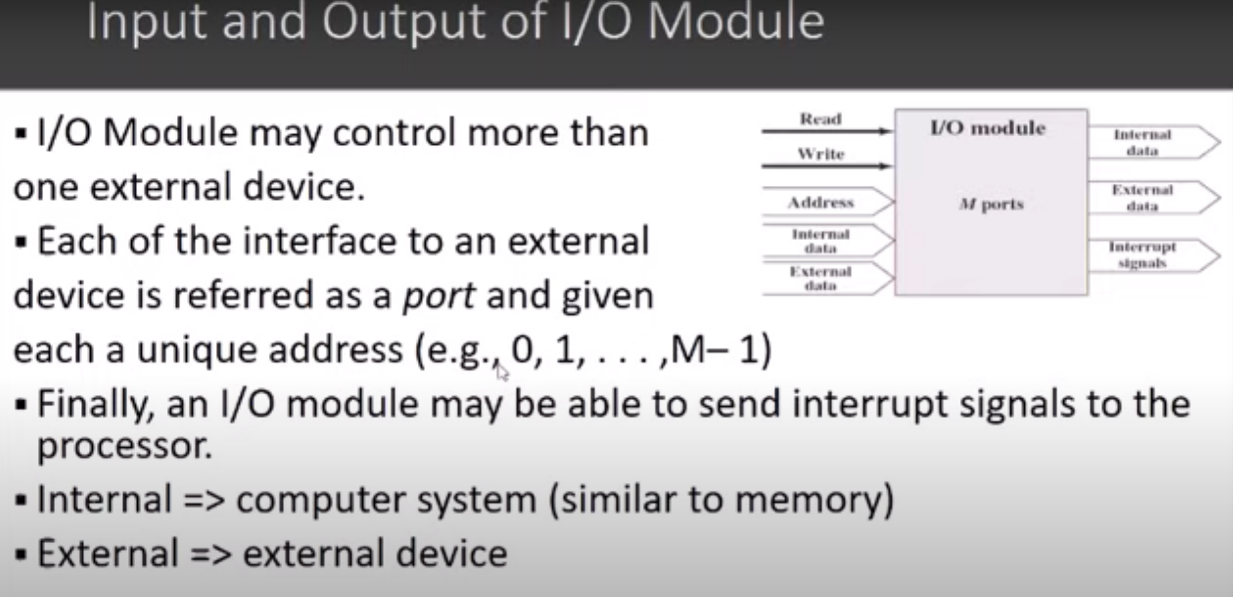

Slide 48
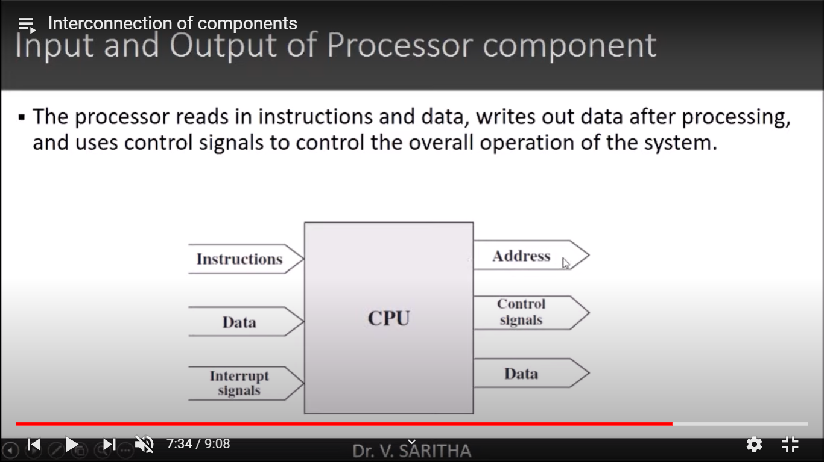

Slide 49
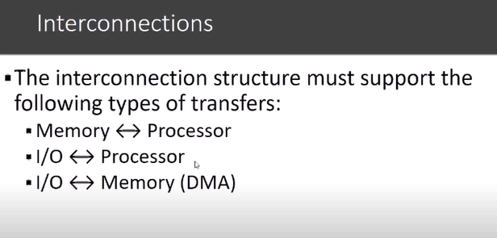

Slide 50
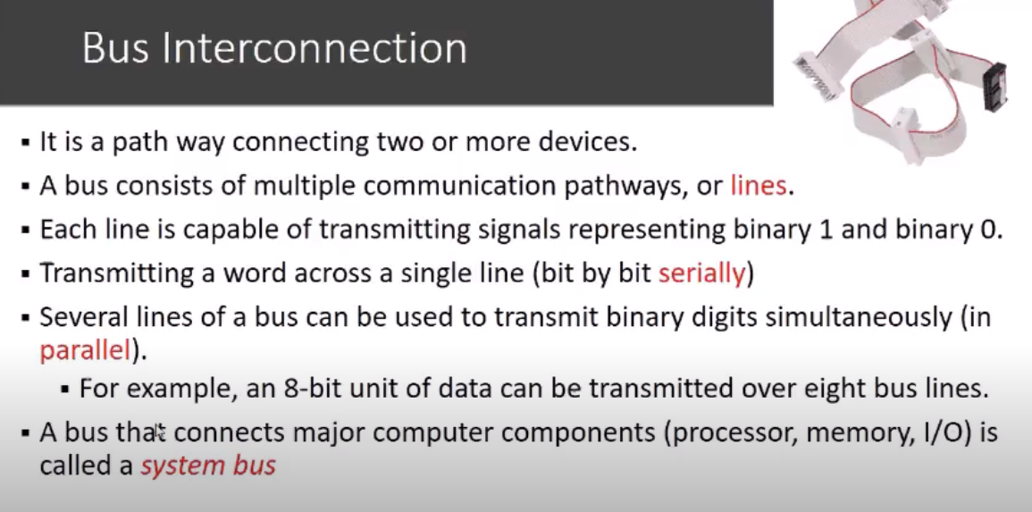

Slide 51
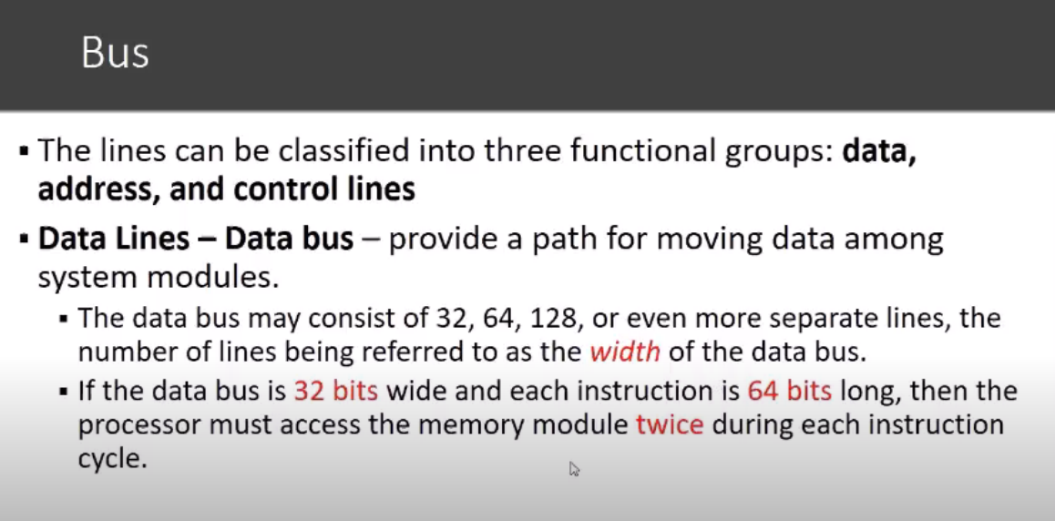

Slide 52
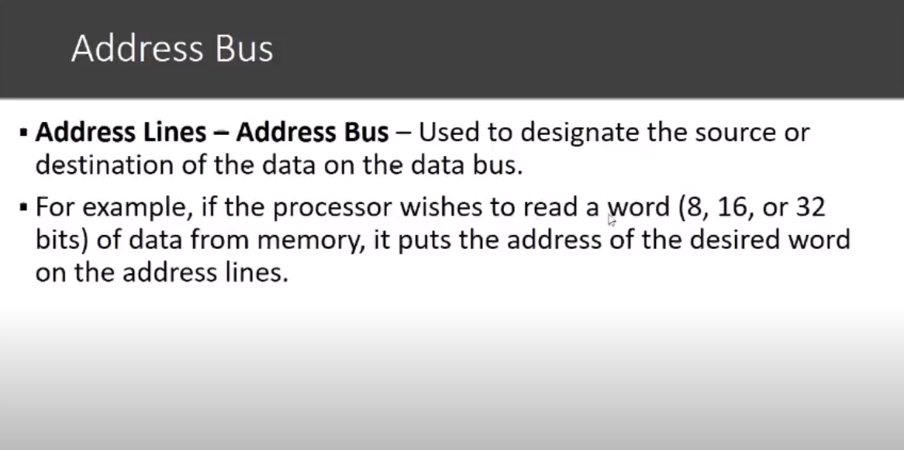

Slide 53
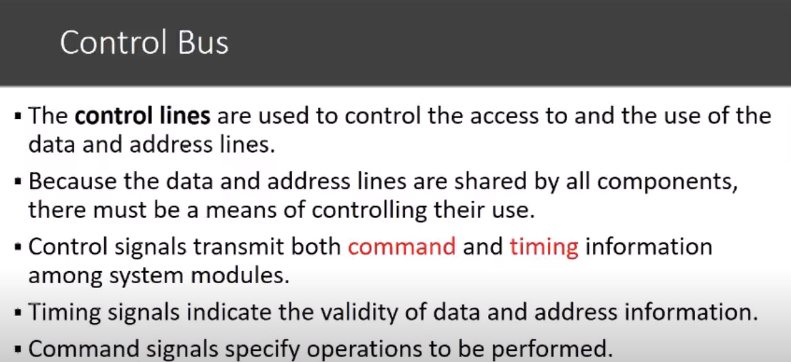

Slide 54
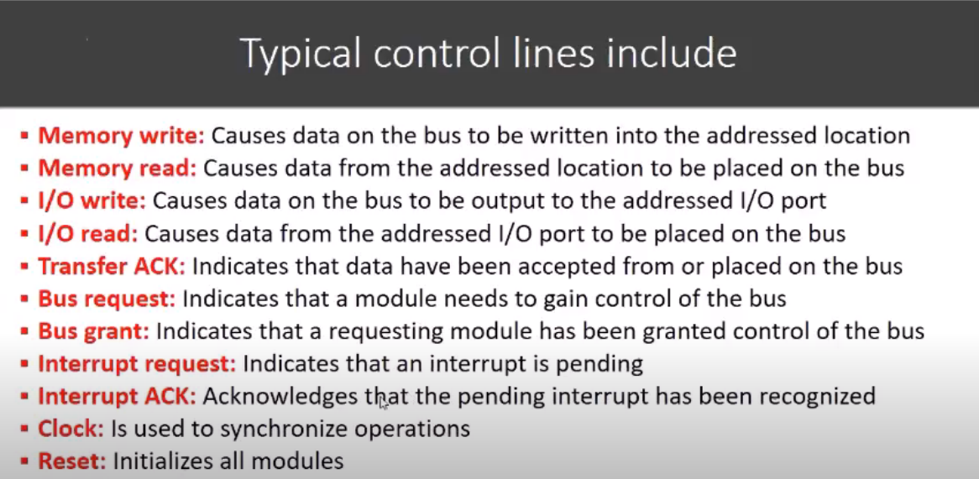

Slide 55
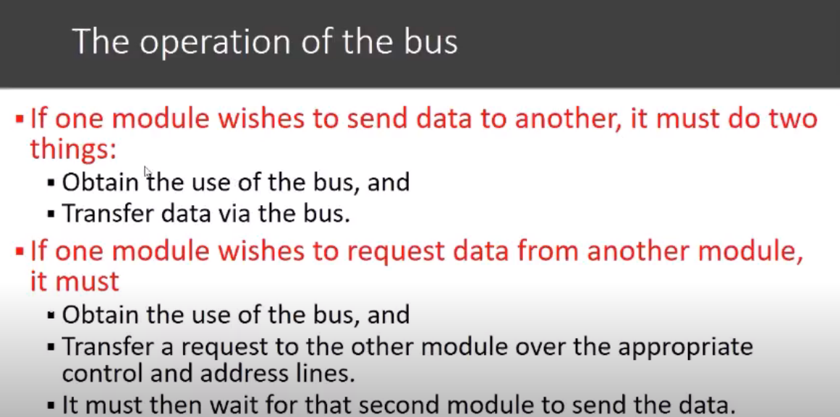
Registers and register files

Slide 56
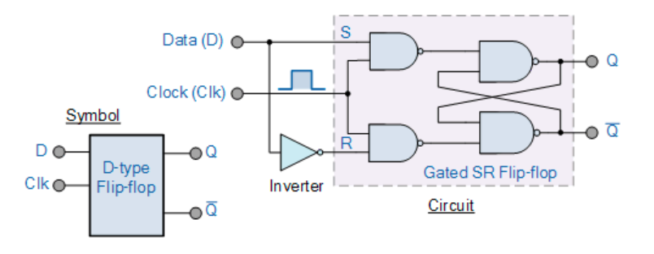
Registers
Register is a very fast computer memory, used to store data/instruction in-execution.
A Register consists of a group of flip-flops and gates that effect their transition.
A Register constructed with four D-type flip-flops and a common clock pulse output.

Slide 57
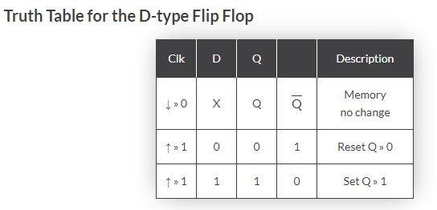
D-type Flip-Flop Circuit

Slide 58
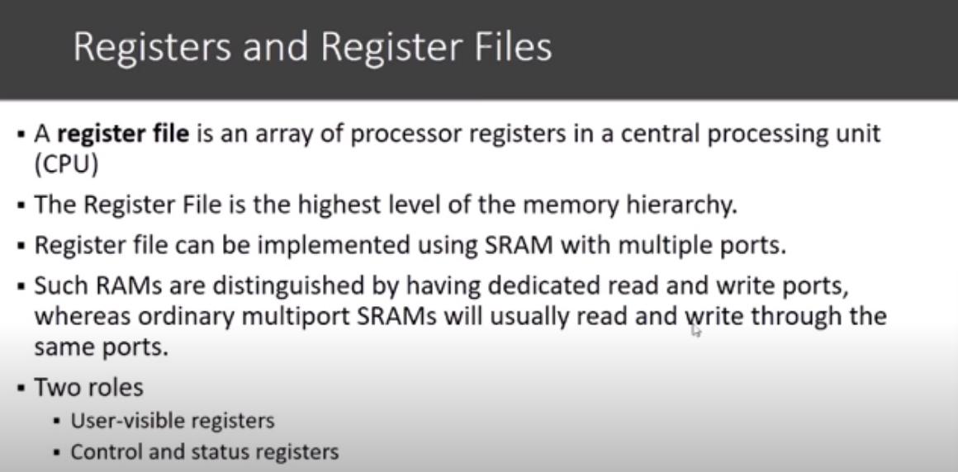
Registers have 3 specific roles:
User visible registers
Condition code registers
Control and status registers

Slide 59
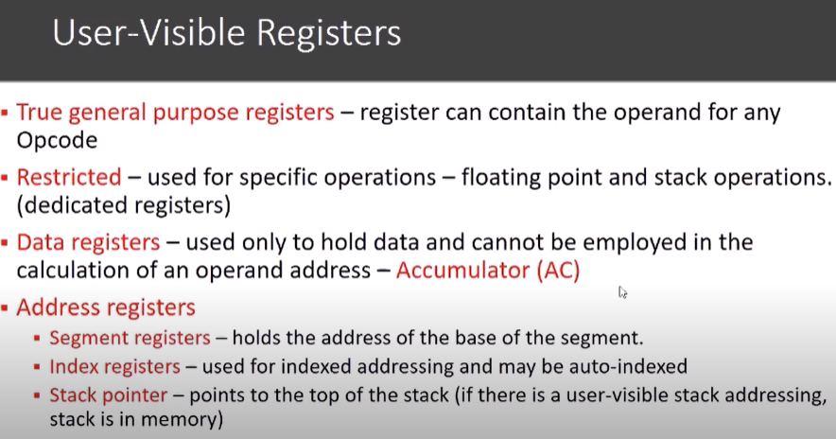

Slide 60

JZ JNZ
ADD AL,BL
ADD BL

Slide 61


Slide 62


Slide 63
Commonly used Registers
Accumulator: This is the most common register, used to store data taken out from the memory.
General Purpose Registers: This is used to store data intermediate results during program execution. It can be accessed via assembly programming.
Data Register : These registers only holds the data. The restriction of these registers is, these can not be used for operand address calculation

Slide 64
Control / Status - Special Purpose Registers:
Users do not access these registers. These registers are for Computer system,
MAR: Memory Address Register are those registers that holds the address for memory unit.
MBR/MDR: Memory Buffer Register stores instruction and data received from the memory and sent from the memory.
PC: Program Counter holds the address of the next instruction to be read from memory after the current instruction is executed.
IR: Instruction Register holds the instruction to be executed.
1000 :Int a =5;
1004:Int c = a+10;

Slide 65
Control / Status registers
Parity Flag (PF) − It indicates the total number of 1-bits in the result obtained from an arithmetic operation.
Sign Flag (SF) − It shows the sign of the result of an arithmetic operation. This flag is set according to the sign of a data item following the arithmetic operation.
Zero Flag (ZF) − It indicates the result of an arithmetic or comparison operation. A nonzero result clears the zero flag to 0, and a zero result sets it to 1.
Auxiliary Carry Flag (AF) − It contains the carry from bit 3 to bit 4 following an arithmetic operation;
Carry Flag (CF) − It contains the carry of 0 or 1 from a high-order bit (leftmost) after an arithmetic operation. It also stores the contents of last bit of a shift or rotate operation.

Slide 66
Control /Status registers
Program status word (PSW): This register contains status information. This also contains condition codes as well as some status information.
Overflow Flag (OF) − It indicates the overflow of a high-order bit (leftmost bit) of data after a signed arithmetic operation.
Direction Flag (DF) − It determines left or right direction for moving or comparing string data.
Interrupt Flag (IF) − It determines whether the external interrupts like keyboard entry, etc., are to be ignored or processed.
Trap Flag (TF) − It allows setting the operation of the processor in single-step mode. The DEBUG program we used sets the trap flag, so we could step through the execution one instruction at a time.

Slide 67
Processor Registers – Intel Architecture
There are ten 32-bit and six 16-bit processor registers in IA-32 architecture. The registers are grouped into three categories −
General registers,
Control registers,
Segment registers.
The general registers are further divided into the following groups −
Data registers,
Pointer registers,
Index registers.

Slide 68

Data Registers

Slide 69

Pointer Registers
The pointer registers are 32-bit EIP, ESP, and EBP registers and corresponding 16-bit right portions IP, SP, and BP. There are three categories of pointer registers −
Instruction Pointer (IP) − The 16-bit IP register stores the offset address of the next instruction to be executed.
Stack Pointer (SP) − The 16-bit SP register provides the offset value within the program stack.
Base Pointer (BP) − The 16-bit BP register mainly helps in referencing the parameter variables passed to a subroutine. The address in SS register is combined with the offset in BP to get the location of the parameter.

Slide 70
Data Registers
Some of these data registers have specific use in arithmetical operations. Add X,20 x= 10
AX is the primary accumulator; it is used in input/output and most arithmetic instructions. For example, in multiplication operation, one operand is stored in EAX or AX or AL register according to the size of the operand.
BX is known as the base register, as it could be used in indexed addressing.
CX is known as the count register, as the ECX, CX registers store the loop count in iterative operations.
DX is known as the data register. It is also used in input/output operations. It is also used with AX register along with DX for multiply and divide operations involving large values.

Slide 71

Index Registers
The 32-bit index registers, ESI and EDI, and their 16-bit rightmost portions.
SI and DI, are used for indexed addressing and sometimes used in addition and subtraction.
There are two sets of index pointers −
Source Index (SI) − It is used as source index for string operations.
Destination Index (DI) − It is used as destination index for string operations.

Slide 72

8086 Microprocessor Register Organization

Slide 73

Register File with 3 Access Ports - Symbol

Slide 74

Data Out A
Data Out B

Slide 75
Instructions, Operands, Opcodes and Addressing
Instructions are operations performed by the CPU.
Operands are entities operated upon by the instruction.
An opcode is short for 'Operation Code'.
Addresses are the locations in memory of specified data.
In assembly language mnemonic form an opcode is a command such as MOV or ADD or JMP.
MOV AL, 34h
In this ex., the operands are the register named AL and the value 34 hex.

Slide 76


Slide 77
Text Book(s)
David A. Patterson and . John L. Hennessy ―Computer Organization and Design-The Hardware/Software Interface‖ 5th edition, Morgan Kaufmann, 2011.
Carl Hamacher, Zvonko Vranesic, Safwat Zaky, Computer organization, Mc Graw Hill, Fifth edition ,Reprint 2011.

Slide 78
Reference Books
W. Stallings, Computer organization and architecture, Prentice-Hall, 8th edition, 2009

Slide 79
Time for Discussion Any Queries??

Slide 80
THANK YOU

